Slide 1

Face Recognition & Facial Attribute Analysis
Abhishek Yadav
Manaswi Mishra
Sapna Mishra

Slide 2

Agenda
Project Introduction and Motivation
Introduction to the Models
Gender Model
Age Model
Transfer Learning using VGGFAce
Age Model trained on VggFace2 -Resnet50
Demonstration using Deep Face
Q&A
Future Work
Data
Race Model
Face Mask Detection

Slide 3
Project Introduction and Motivation

Slide 4
Project Introduction and Motivation
Predict Gender, Age and Race from facial images
Implement Custom Convolutional Neural Networks
Explore Transfer Learning Models
Motivation:
Implement different model architectures
Target specific audience for advertising
Understand customer behavior and campaign feedback
Surveillance system to follow COVID-19 face mask guidelines

Slide 5
Data Procurement & Specifications

Slide 6
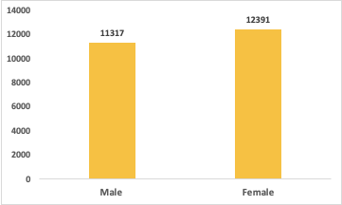
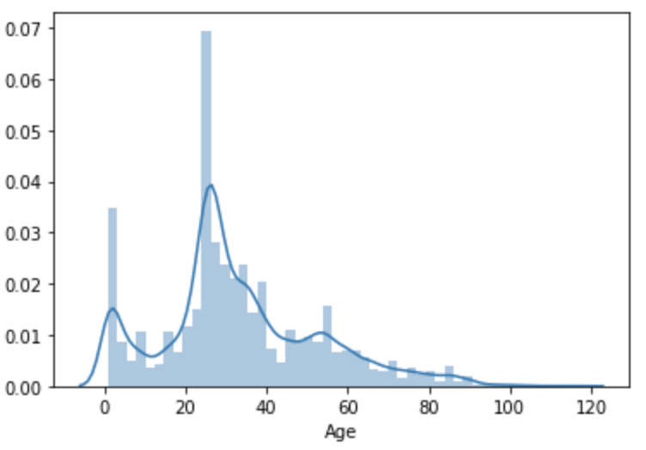
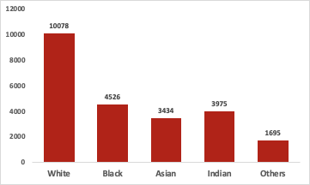
Data
Gender
UTK Dataset
23,000 facial images with annotations for age, gender, and age
Balance between Male and Female
Age is right skewed
For Race, white is dominant in the data set
Images are aligned and only contain cropped faces
Images show variation in pose, facial expression, illumination and resolution
Age Distribution
Race

Slide 7
Introduction to the Models
Initial Considerations for building the Model:
Gender – Female/Male
Age – Children, Youth, Adult, Middle Age, Very Old (>60)
Race - White, Black, Asian, Indian and Hispanic-Latino

Slide 8
Introduction to the Models

Slide 9
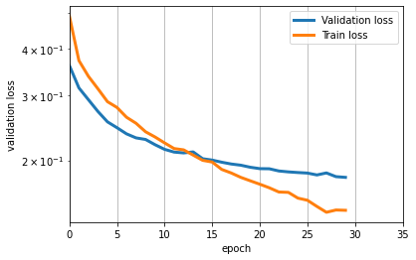
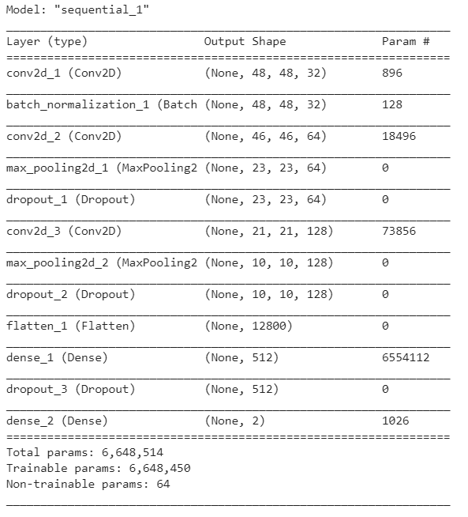
Gender Model
Data Pre-Processing
Reshape- shaping the image size (50x50 was the final one)
Gray Scale
Normalizing
Data Augmentation
Zooming images
Changing the image brightness
Flipping the images horizontally
Mutiple Model iterations to find best model characteristics using Grid search
Train Accuracy :- 97%
Test Accuracy:- 95%

Slide 10
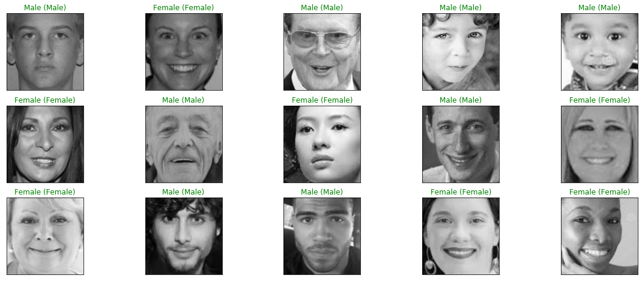
Gender Model - Predictions

Slide 11
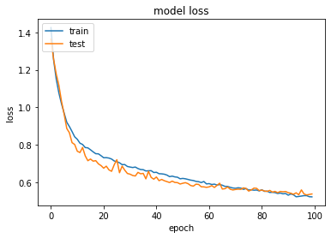
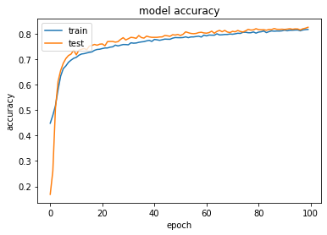
Race Model
Data Pre-Processing
Reshape- shaping the image size (128x128 was the final one)
Gray Scale
Normalizing
Data Augmentation
Zooming images
Changing the image brightness
Flipping the images horizontally
Train Accuracy :- 90%
Test Accuracy:- 83%

Slide 12
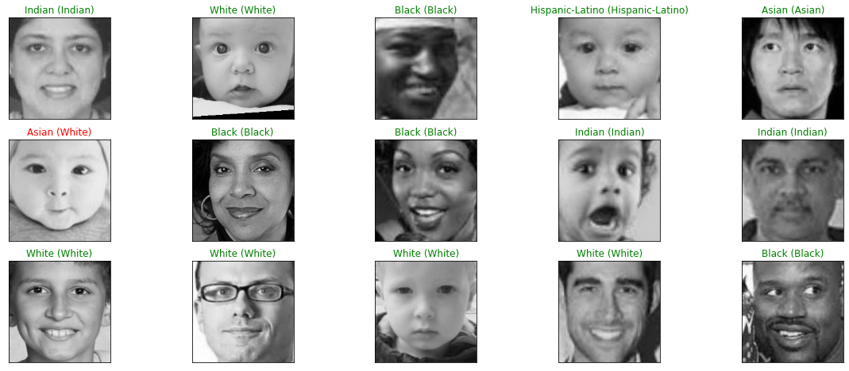
Race Model - Predictions

Slide 13
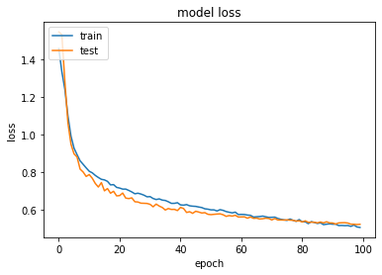
Age Model
Data Pre-Processing
Reshape- shaping the image size (128x128 was the final one)
Gray Scale
Normalizing
Data Augmentation
Zooming images
Changing the image brightness
Flipping the images horizontally
Train Accuracy :-85%
Test Accuracy:- 80%

Slide 14
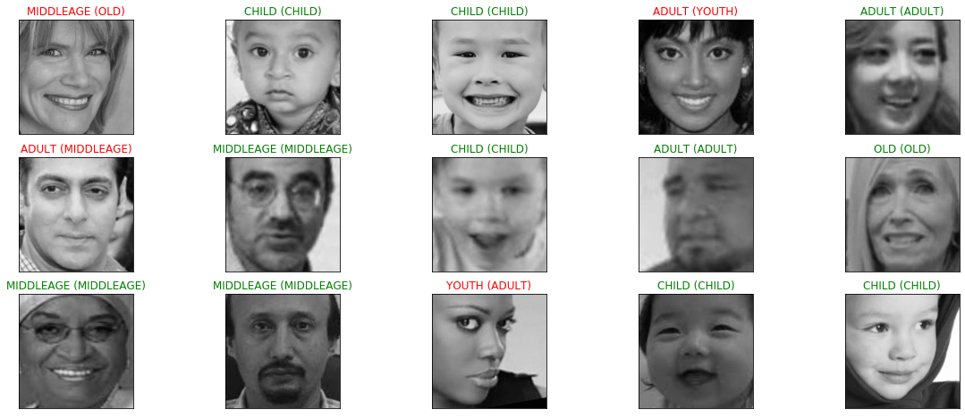
Age Model - Predictions

Slide 15
Re- building Model using Pre-trained Models

Slide 16
Transfer Learning
Why use Transfer learning?
Pre-Trained models are built on millions of datasets. To improve the accuracy of our models we decided to use pre-trained models.

Slide 17
Keras VGGFace2 - Resnet50
Face recognition is a computer vision task of identifying and verifying a person based on a photograph of their face.
VGGFace and VGGFace2 model developed by researchers at the Visual Geometry Group at Oxford.
Although the model can be challenging to implement and resource intensive to train, it can be easily used in standard deep learning libraries such as Keras through the use of freely available pre-trained models and third-party open source libraries.

Slide 18
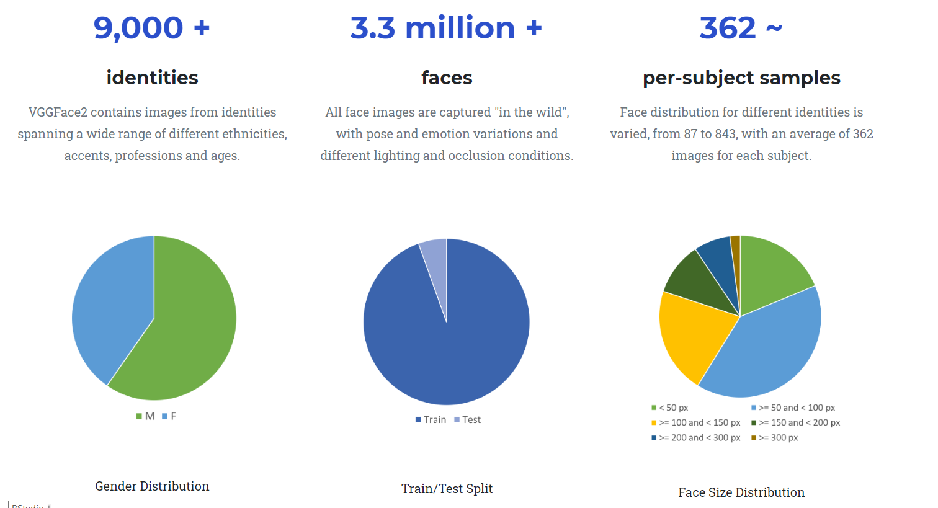
Keras VGGFace2 - Resnet50

Slide 19
Age Model using pretrained VGGFace2
12 classes = ["0-2","3-5","6-10","11-15","16-20","21-25","26-30","31-35","36-40","41-50","51-59",">=60"]
Specifications: Input Image size (224x224)
Train Accuracy : 60%
Test Accuracy: 58%

Slide 20
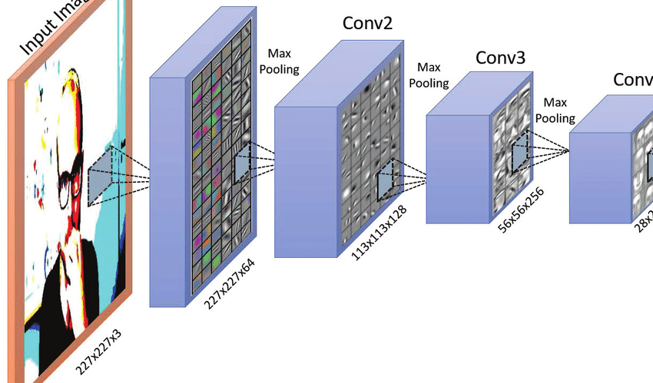
Visualizing the final Age Model Architecture
Softmax:- 12 classes =
["0-2","3-5","6-10","11-15","16-20","21-25","26-30","31-35","36-40","41-50","51-59",">=60"]

Slide 21
Demonstration

Slide 22
Demonstration using Deep Face Libraries
Deepface is a lightweight facial analysis framework including face recognition and demography detection.
Emotions - Angry, Fear, Neutral, Sad, Disgust, Happy and Surprise
It has 4 extended models that is used to detect the demographic details of the given image, they are Gender, Race, Age (exact age) and Emotions.

Slide 23
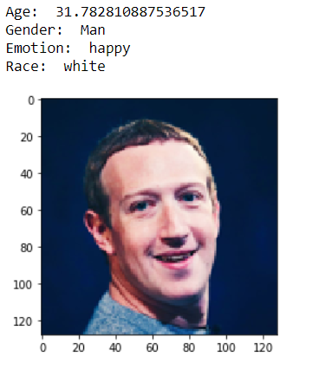
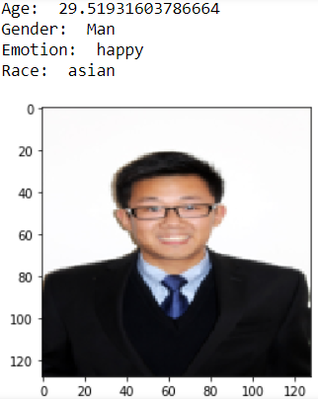
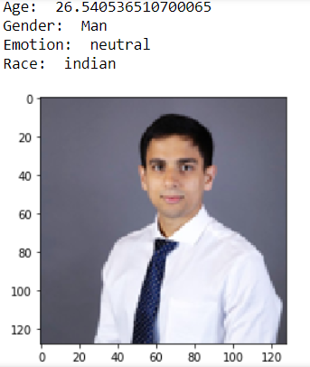
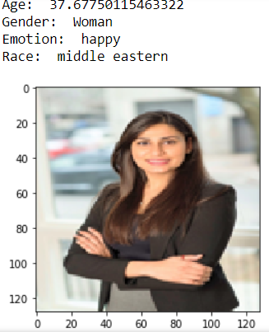
Sample Detection Results

Slide 24
Future Work

Slide 25
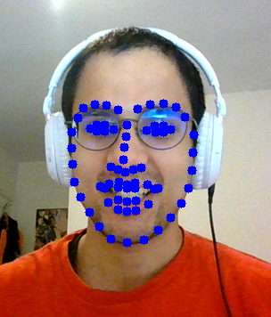
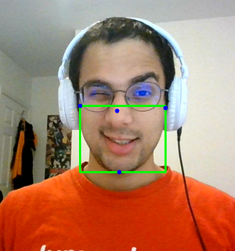

Face mask using OpenCV
Data Pre-Processing
Created a method through which we were able to identify 50+ face contour points
Based on the detection overlaid a face mask using CV2 which overlapped the facemask on live camera
Created a dataset of people with facemask and without face mask
Ran a classification model on the face mask detection using CNN
Train Accuracy :-100%
Test Accuracy:- 99.9%
https://www.youtube.com/watch?time_continue=8&v=pHmSubIbK2U&feature=emb_logo

Slide 26

Future Work
Improve existing model performance by fine tuning the pretrained model layers.
Try other Data Augmentation techniques to increase data size and to handle data imbalance
Check for other alternative Face recognition models like Facenet and Googlenet
Include face mask rotation as well as Mutiple mask implementations

Slide 27
References

Slide 28

References
https://susanqq.github.io/UTKFace/
https://modelzoo.co/
https://pypi.org/project/deepface/
http://www.robots.ox.ac.uk/~vgg/data/vgg_face2/
https://machinelearningmastery.com/how-to-perform-face-recognition-with-vggface2-convolutional-neural-network-in-keras/

Slide 29

Questions

Slide 30
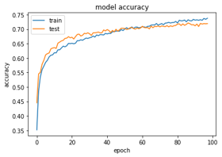
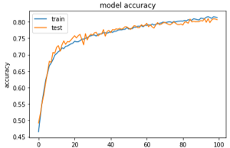
Appendix

Slide 31
Gender Model using pretrained VGGFace2
2 classes =["Female", "Male"]
Specifications: Input Image size (224x224)

Slide 32
Race Model using pretrained VGGFace2
5 classes = ["White", "Black", "Asian", "Indian", "Hispanic-Latino"]
Specifications: Input Image size (224x224)

